Slide 1



We challenge conventional
packaging for a
Sustainable future
Susanne Lithander, CFO

Slide 2
BILLERUDKORSNÄS in brief
PURE PLAY PACKAGING COMPANY
NET SALES
Europe 73%
Asia 17%
Africa 4%
South America 3%
Middle East 2%
Other 1%
OTHER
PACKAGING PAPER
21.7
SEKbn
Kraft paper
Sack paper
Market pulp
SHARE
OF SALES
EBITDA
CONSUMER BOARD
17%
3.6
SEKbn
Liquid packaging board
Cartonboard
CORRUGATED SOLUTIONS
Fluting
Liner
Managed Packaging
MARGIN
8
3.0
4,300
PRODUCTION UNITS
(SWE, FI, UK)
PRODUCTION CAPACITY
(MILLION TONNES)
NUMBER OF EMPLOYEES
Full year 2016

Slide 3
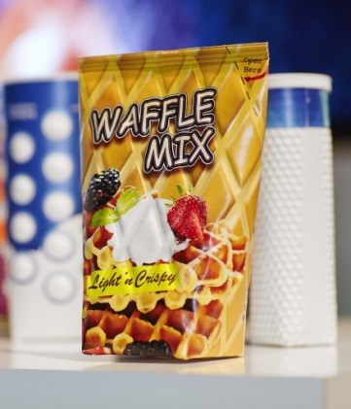
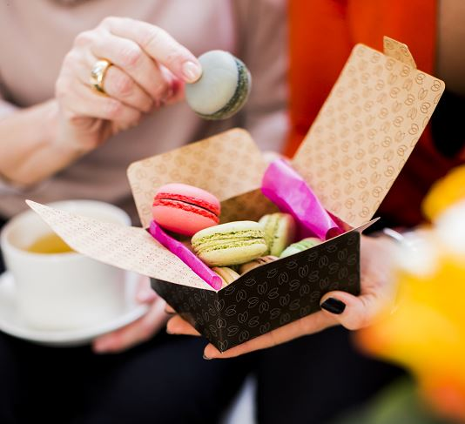
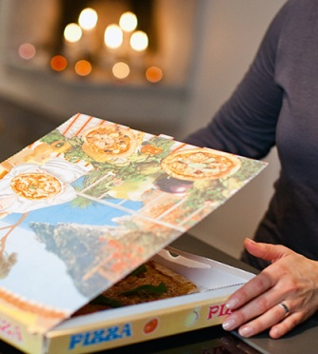
THREE BUSINESS AREAS
PACKAGING PAPER
Kraft and sack paper for
customers with tough demands
CONSUMER BOARD
Liquid packaging board and
cartonboard with uniqe properties
CORRUGATED SOLUTIONS
Fluting and liner add value
Packaging for flour, sugar, carrier bags, medical packaging, building materials, chemicals and more
Growth driven by population growth in emerging markets, ageing population, increasing environmental awareness and more
Packaging for milk, juice, preserved foods, beauty and healthcare products, confectionary and more
Growth driven by high urbanization rate, change in consumer behavior and more
Packaging for fruit and vegetables, white goods and electronics, exclusive drinks and more
Supply chain solutions and packaging optimisations for brand owners
Growth driven by increasing e-commerce and fresh food consumption, package differentiation and changing supply chains
SELECTIVE GROWTH
VOLUME GROWTH
VALUE GROWTH
Asset transformation for increased profitability
Attractive market providing growth opportunities
Strong product portfolio setting market standard
2-4%
CAGR
Development of new business models
4-5%
CAGR
Investments for volume growth
2-4%
CAGR
Integrating new business model
Expansion to growing markets
Innovation with customers and brand owners
Increasing sales to brand owners

Slide 4
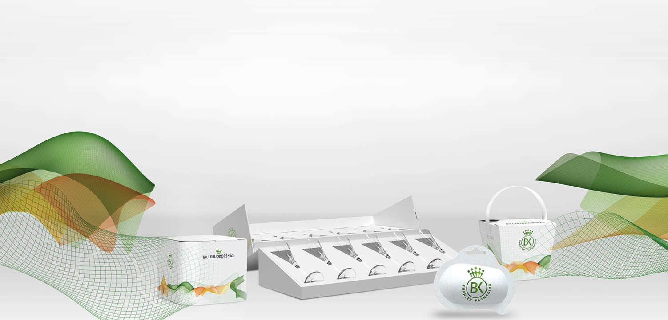
INVESTMENT HIGHLIGHTS
1.
Leading
position in
our
segments
2.
Growth
segments backed
up by global
megatrends
3.
Clear growth
strategy to
capture
market potential
4.
Clear innovation
focus for a
sustainable
future
5.
Stable earnings
and shareholder
returns
Notes:
Well-positioned to take advantage of growth opportunities
Well-positioned for profitable growth

Slide 5
LEADING POSITION IN OUR SEGMENTS
1. Leading position
in our segments
Packaging
Paper
Consumer
Board
Corrugated Solutions
Only primary fibre
in portfolio targeting customers and applications requiring light, strong and pure materials
KRAFT PAPER
#1
GLOBALLY
LIQUID
PACKAGING BOARD
– AMBIENT PACKAGES
#1
GLOBALLY
NSSC FLUTING
#1
EUROPE
SACK PAPER
#2
GLOBALLY
LIQUID
PACKAGING BOARD
– ALL PACKAGE TYPES
#2
GLOBALLY
PURE WHITE LINER
#2
EUROPE
95%
75%
COATED WHITE TOP LINER
#2
EUROPE
packaging material in product portfolio with a growing share of services and solutions
of sales towards consumer segment with stable long-term demand growth
No 1 or 2 within niches
where we operate

Slide 6


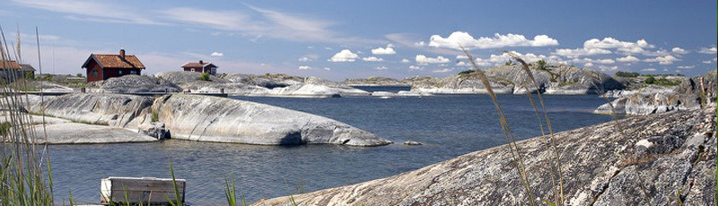
Growth segments backed up by global megatrends
2. Growth segments backed
by global megatrends
Global megatrends driving long-term demand for packaging material
  Urbanisation
  E-commerce
Sustainability awareness is increasing demand for renewable packaging material

Slide 7
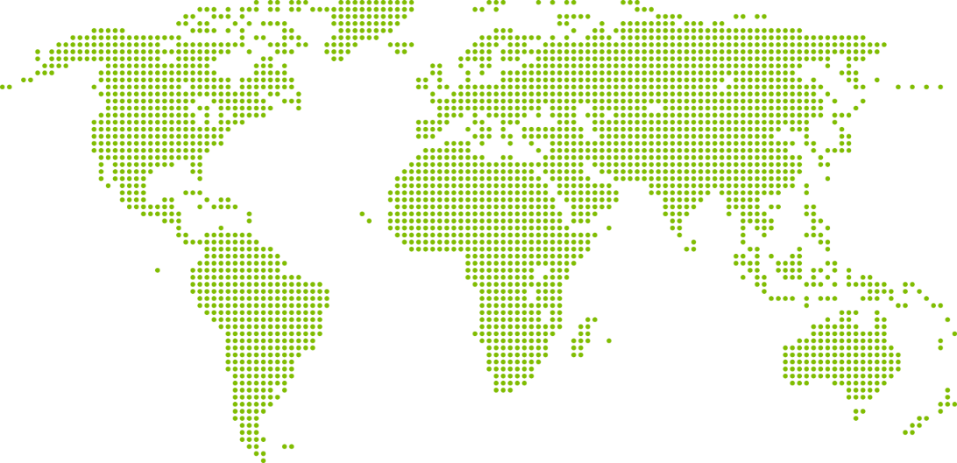
TARGETING THE GLOBAL PACKAGING MARKET
2. Growth segments backed
by global megatrends
0.3%
1.5%
2.0%
1.8%
3.3%
3.0%
4.7%
5.1%
2.8%
4.4%
2.7%
3.7%
0.4%
2.2%
Global market for packaging paper & board has a growth
of 2.2%
We aim to expand sales in the global packaging market…
…with a growth of 3.4%
Key to success is new packaging solutions and sustainable products
PP & Board market: Estimated demand CAGR 2013-2030, combined market for cartonboard, containerboard and sack paper. Source: Pöyry 2014
Global Packaging Market: Estimated CAGR 2014-2024, for all packaging materials. Source: Smithers Pira 2014

Slide 8
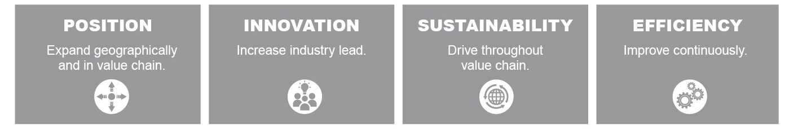
Clear growth strategy to capture market potential
3. Clear growth strategy to capture market potential
Increasing sales of solutions to brand owners and expanding sales outside Europe
Increasing innovation efforts to develop new packaging solutions expanding potential market segments
Maximizing customer value by offering sustainable products challenging alternative materials
Continuously improving production efficiency
Aim to reach profitable growth of 3-4% per year

Slide 9

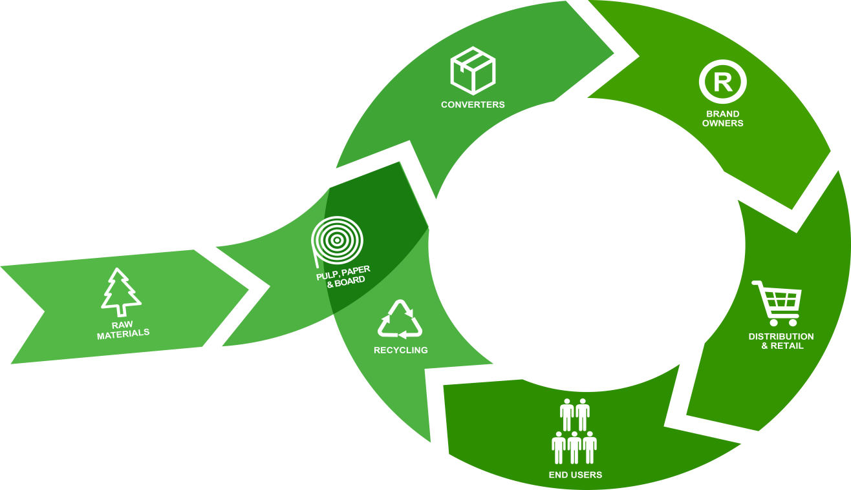
3. Clear growth strategy to capture market potential
WE are investing to move further up the value chain towards brand owners
Packaging material
50-85 % of
the cost
Packaging material
2-5% of
the cost
Price
Payment terms
Runability
Delivery terms
Brand image
Package solution
Sustainability
Shelf appearance

Slide 10
Two major restructuring projects
3. Clear growth strategy to capture market potential
IMPROVING EFFICIENCY AND SECURING GROWTH
1
Moving unintegrated MG paper machine from Tervasaari, Finland to Skärblacka, Sweden and making it integrated to the pulp production.
SEK 1.3 billion investment.
Karlsborg
Pietarsaari
2
Building new board machine at the production unit in Gruvön with capacity of approx. 550,000 t/a of liquid packaging board, cartonboard, food service board and white kraftliner.
SEK 5.7 billion investment.
Tervasaari
Gävle
2
Frövi
Rockhammar
Gruvön
1
Skärblacka
Beetham
Production start on MG machine in Skärblacka
Production start on board machine in Gruvön
Machine in Gruvön fully utilised
2
1
Q2
2016
Q4
2016
Q1
2018
Q1
2019
2023

Slide 11
PRODUCTION AND CAPEX IMPACT
3. Clear growth strategy to capture market potential
PRODUCTION
CAPEX
ktonnes
SEKm
4 700
4 300
550
330
1 645
1 500
1 300
Notes:
Current paper production at Gruvön will gradually be transferred to other plants within the company during ramp up of the new board machine, with the aim of offering customers fully satisfactory alternatives
Gruvön’s production of high quality fluting will not be affected by the investment

Slide 12
INVESTMENTS To improve underlying profitability and secure organic growth
3. Clear growth strategy to capture market potential
PACKAGING PAPER
Selective growth
CONSUMER BOARD
Volume growth
CORRUGATED SOLUTIONS
Value growth
Focusing on growth segments growing by 2-4% per year
Decreasing volumes on oversupplied markets
Increasing volumes on growing Liquid Packaging Board and Cartonboard markets
Expanding solution based sales to brand owners
Exiting oversupplied white liner market
Improved underlying EBITDA > +1 200 SEKm when fully implemented
Continued growth with 3-4% per year
Lower currency
exposure
- SEK 2 bn
Reduced price
volatility in
product portfolio
Limited
exposure
to pulp
market
ROI well above
our return target
of 13%

Slide 13
Clear innovation focus for a sustainable future
4. Clear innovation focus
for a sustainable future
Proportion of sales accounted for by new products
Long history of award winning packaging innovations
Challenging boundaries of fibre based packaging in order to reduce usage of fossil materials
Innovation will strengthen top line and margins
13%
2016
20%
2020 Target
2013: Axello® ZAP
2014: D-Sack
2015: FreeFormPack®
2016: QuickFill® Clean

Slide 14
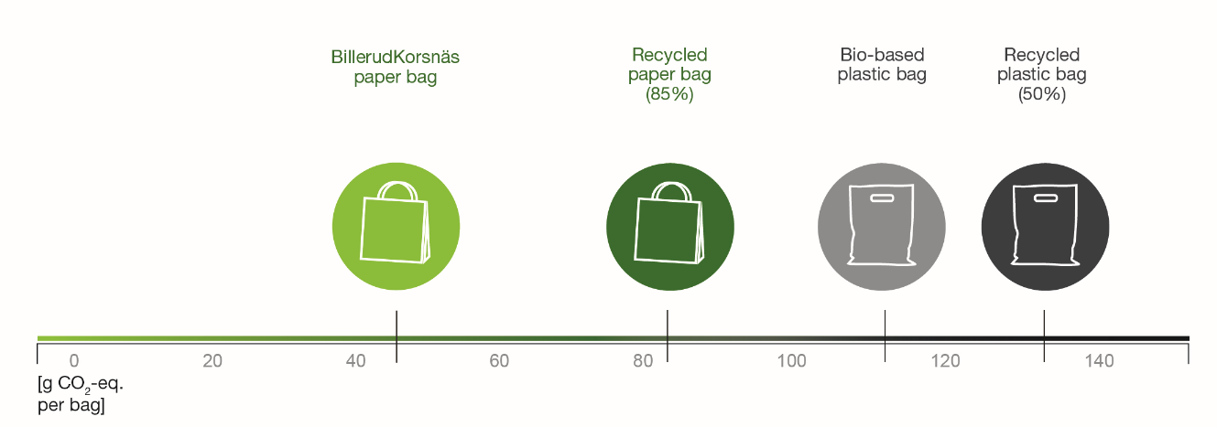
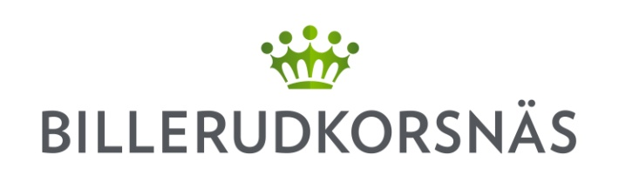



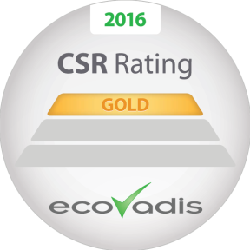
We PROVIDE Sustainable Solutions
4. Clear innovation focus
for a sustainable future
Paper bag* - Best choice for the climate
MAXIMIZING
POSITIVE IMPACT
INCREASED
CUSTOMER VALUE
SUSTAINABLE
AND BIO-BASED
SOCIETY
Walk the talk
RESPONSIBLE VALUE CHAIN
ADVANCED LEVEL
MINIMIZING NEGATIVE
IMPACT
Towards fossil-free production
97.5%
Biofuels used in 2016
*BillerudKorsnäs paper bag from primary fibre, produced in Sweden

Slide 15

STABLE EARNINGS AND SHAREHOLDER RETURNS
5. Stable earnings and
shareholder returns
Stable underlying earnings over recent years
Average ROCE of 13% during the history of the company
Average TSR of 23% per year for past 5 years
Proven track record of accretive investments
ROCE

Slide 16
SELECTIVE M&A TO SUPPORT LONG-TERM GROWTH
5. Stable earnings and
shareholder returns
We have the financial capacity to add M&A growth to organic growth
We have proven experience in merging businesses and extracting synergies
Bolt-on acquisitions with synergy potentials are currently the most interesting candidates

Slide 17
FINANCIAL TARGETS AND TARGET FULFILLMENT
5. Stable earnings and
shareholder returns
FULL YEAR 2016
Area | Target | Outcome 2016
Growth
EBITDA
ROCE
Net debt/EBITDA
Dividend policy
1
3-4%
0.3%
>17%
2
✔
18%
2
>13%
14%
✔
<2.5
1.1
✔
50%
59%
✔
17
For comparable units (excluding divested and acquired operations)
Excluding non-recurring items

Slide 18

summary
Focused product portfolio with leading global and regional positions
in growing markets
Global trends imply growth opportunities
  Sustainability, demographic shifts, digitalization and changed consumer behavior
We invest in all of our four strategic pillars:
  Position expansion, Innovation, Sustainability and Efficiency
Two major restructuring projects to increase profitability and secure long-term growth
Strong financial position with low leverage and a well-balanced leverage policy

Slide 19
Q2 DEVELOPMENT

Slide 20
Q2 2017 RESULTS AT A GLANCE
NET SALES
3%
PACKAGING PAPER
5 600
SEK million
OTHER
Kraft paper
Sack paper
Market pulp
GROWTH
SHARE
OF SALES
EBITDA
15%
CONSUMER BOARD
863
SEK million
Liquid packaging board
Cartonboard
CORRUGATED SOLUTIONS
Fluting
Liner
Managed Packaging
MARGIN
Notes:
The market for sustainable packaging materials and solutions remains very encouraging. We delivered a stable result in the second quarter, despite the pressure from costs of external factors and the major disruption at Gruvön, which was communicated in May.
Net sales amounted to SEK 5600 million and EBITDA to SEK 863 million, with a 15% margin.

Slide 21

Q2 2017 KEY HIGHLIGHTS
Continued high demand across all business areas
Stable production volumes
EBITDA affected by one-off and extra costs of SEK 55 million and maintenance shutdown costs of SEK 230 million
Strong operating cash flow
Favourable outlook on both short and long term
Notes:
The business areas showed stable performance over the quarter on a strong market and we see some positive development in local prices. Consumer Board is showing volume growth of around 6% compared with the first half of last year.
Production was relatively stable and we had planned maintenance shutdowns at three of our production units over the quarter, which cost SEK 25 million more than we had estimated. In addition, we had SEK 25 million in costs for the shutdown of the pulp line for the fluting machine at Gruvön, as well as additional costs related to Rockhammar of approximately SEK 30 million. Our results were also negatively affected by increased costs of deliveries due to the strike at the Port of Gothenburg.
The quarter also saw strong and healthy operating cash flow.
Looking ahead, we see that the path we have chosen is the right one. Markets are performing strongly over the short term, and in the long term the trend points to companies being ambitious in their sustainability efforts both in their business operations and their products. The prospects for growth are good.

Slide 22
FinanCIal development

Slide 23
NET SALES
SEK million
+3%
2015
2016
2017
Notes:
Net sales were 3% higher than in the corresponding period last year and underlying organic growth in sales was 3%. This positive development was mainly due to improved exchange rates, combined with improved market prices for Liner and Sack Paper.

Slide 24
EBITDA
SEK million
0%
2015
2016
2017
Notes:
EBITDA was in line with the same period last year. Increased costs for the purchase of external pulp for Frövi, due to the rebuild of Rockhammar, as well as increased costs for energy and chemicals were offset by favourable exchange rates and lower maintenance shutdown costs. Costs for planned maintenance shutdowns amounted to approximately SEK 230 million, compared with approximately SEK 245 million for the same period last year.

Slide 25
OPERATING CASH FLOW
SEK million
2015
2016
2017
Notes:
Operating cash flow in the first half of 2017 amounted to SEK 20 million (786). The decrease was mainly due to the level of investment increasing due to investments in Gruvön and Skärblacka. Working capital in relation to sales was 10% for the quarter, which is an improvement on the first quarter of 2017 when it was 11%.

Slide 26
RETURN ON CAPITAL EMPLOYED
Adjusted, rolling 12 months (%)
Target: >13%
2015
2016
2017
Notes:
Capital employed at 30 June 2017 amounted to SEK 17 688 million (17 435). Return on capital employed (ROCE), calculated over the last 12-month period, amounted to 11% (14%). The last 12-month period was affected by restructuring costs at Gruvön. The 12-month figure for June 2016 was affected by the capital gain from the Latgran divestment. ROCE calculated using adjusted operating profit amounted to 13% (13%).

Slide 27
LEVERAGE
NET DEBT/EBITDA (X)
Target: <2.5x
2015
2016
2017
Notes:
Interest-bearing net debt at 30 June 2017 amounted to SEK 4 734 million (5 204). The Group’s interest-bearing net debt in relation to EBITDA at the end of the period was 1.35 (1.32). The target is to have a ratio below 2.5

Slide 28
BUSINESS AREAS
Notes:
Moving to the business areas.

Slide 29
packaging paper Business area
Kraft and sack paper for customers with tough demands
KRAFT PAPER
#1
GLOBALLY
SACK PAPER
#2
GLOBALLY
Packaging for flour, sugar, carrier bags, medical packaging, building materials, chemicals and more
Growth driven by population growth in emerging markets, ageing population, increasing environmental awareness and more
SELECTIVE GROWTH
Asset transformation for increased profitability
2-4%
CAGR
Development of new business models
Expansion to growing markets
Notes:
Starting with Packaging Paper where we offer kraft and sack paper of premium quality plus smart solutions for customers in the industrial, medical equipment and consumer segments. We focus on sustainable and profitable growth in chosen segments with a growth target of 2-4% per year.

Slide 30
packaging paper Business area
Q2 DEVELOPMENT
2 151
Continued strong performance
Net sales +3% vs Q2-16
  Improved FX and increased local prices
EBITDA +17% vs Q2-16
  Good sales mix, increased local prices and favourable FX
Improved market for all kraft and sack papers
Q3 sales expected to be on par with Q2
Kraft and sack paper markets expected to remain stable with potential to increase prices in local currency
NET SALES SEK MILLION
312
EBITDA SEK MILLION
15%
EBITDA MARGIN
Notes:
As a result of improved exchange rates and increased local prices, net sales increased by 3% compared with the second quarter of 2016, despite sales volumes being 2% lower due to the closure of the Tervasaari production facility in September 2016.
EBITDA rose by 17% compared with the same period last year, as a result of better sales mix and higher prices, as well as favourable exchange rates. Higher pulp costs in non-integrated mills due to unfavourable pulp prices had a negative impact on EBITDA in the second quarter of 2017 compared with the second quarter of 2016.
Market conditions were stable and favourable during the quarter. The market improved compared with previous quarters for all sack and kraft papers. Prices in local currency increased slightly for sack papers and remained stable for kraft papers compared with previous quarters.
The market for NBSK pulp remained stable and positive in the quarter compared with the previous quarter. Prices were around USD 890 per tonne at the end of the quarter compared with USD 820 at the end of the previous quarter. The price of pulp at the end of the second quarter of 2016 was USD 810 per tonne.
In the next quarter, overall Packaging Paper sales are expected to be on a par with the second quarter. Kraft and sack paper markets remain solid, with the potential to increase prices in local currency.

Slide 31
CONSUMER BOARD Business area
LIQUID PACKAGING BOARD AND CARTONBOARD WITH UNIQUE PROPERTIES
LIQUID
PACKAGING BOARD
– AMBIENT PACKAGES
#1
GLOBALLY
LIQUID
PACKAGING BOARD
– ALL PACKAGE TYPES
#2
GLOBALLY
Packaging for milk, juice, preserved foods, beauty and healthcare products, confectionary and more
Growth driven by high urbanization rate, change in consumer behavior and more
VOLUME GROWTH
Attractive market providing growth opportunities
4-5%
CAGR
Investments for volume growth
Innovation with customers and brand owners
Notes:
Moving on to Consumer Board where we deliver packaging materials in high-quality board made from primary fibre for beverages, food products and various other consumer goods. We focus on sustainable and profitable volume growth in the key markets with a growth target of 4-5% per year.

Slide 32
CONSUMER BOARD Business area
Q2 DEVELOPMENT
2 099
Continued volume growth
Net sales +4% vs Q2-16
EBITDA +4% vs Q2-16
  Increased sales volumes
Continued growth in all parts
Expected continued firm order situation for liquid packaging board with normal season varieties and further improved order situation for cartonboard
NET SALES SEK MILLION
498
EBITDA SEK MILLION
24%
EBITDA MARGIN
Notes:
Sales and sales volumes increased by 4% compared with the second quarter of 2016.
EBITDA rose by 4% compared with the second quarter of 2016. The increase was mainly due to higher sales volumes.
We are seeing continued growth across all parts of the Consumer Board business area. The increase is in line with the Group’s growth strategy. Prices in local currency were unchanged compared with the previous quarter.
Looking ahead, orders for liquid packaging board are expected to remain stable and satisfactory with normal seasonal variations. Orders for cartonboard are expected to improve further.

Slide 33
CORRUGATED SOLUTIONS Business area
FLUTING AND LINER ADD VALUE
Packaging for fruit and vegetables, white goods and electronics, exclusive drinks and more
Supply chain solutions and packaging optimisations for brand owners
Growth driven by increasing e-commerce and fresh food consumption, package differentiation and changing supply chains
NSSC FLUTING
#1
EUROPE
COATED WHITE TOP LINER
#2
EUROPE
PURE WHITE LINER
#2
EUROPE
VALUE GROWTH
Strong product portfolio setting market standard
2-4%
CAGR
Integrating new business model
Increasing sales to brand owners
Notes:
In Corrugated solutions we supply materials to corrugated board manufacturers and packaging solutions to brand owners. We achieve sustainable and profitable growth through value growth, without necessarily investing in the existing production capacity for paper. Our growth target is 2-4% per year.

Slide 34
CORRUGATED SOLUTIONS Business area
Q2 DEVELOPMENT
902
Net sales +8% vs Q2-16
  Improved local prices and FX
EBITDA +25% vs Q2-16
  Lower maintenance cost
  Negative impact from digester breakdown
Strong order books and increased prices in Europe
Expected continued strong demand for fluting and liner with potential for local price increases
Managed Packaging is forecasted to continue delivering consistently strong sales growth
NET SALES SEK MILLION
163
EBITDA SEK MILLION
18%
EBITDA MARGIN
Notes:
Net sales rose by 8% compared with the same quarter in 2016 as a result of improved local prices and exchange rates. Managed Packaging showed continued favourable sales growth compared with last year.
EBITDA increased by 25% compared with the second quarter of 2016, mainly due to lower maintenance shutdown costs as the second quarter of last year was affected by a complete shutdown at Gruvön, while the year’s maintenance shutdown was divided across both the first and second quarters. The business area was burdened by the full cost of SEK 25 million for the pulp mill breakdown at Gruvön.
The liner and fluting order books remained strong, with improved price levels in Europe. Managed Packaging delivered further sales growth and saw record-high monthly sales volumes for May and June.
Demand for fluting and liner are expected to remain strong on all markets and there is good potential for continued international expansion and local price increases. Managed Packaging is expected to continue delivering sales growth both through new customers and increased volumes from existing customers.

Slide 35
OUTLOOK

Slide 36
outlook
Demand and order situation are expected to be strong in the third quarter with normal seasonal variances for all business areas.
The Packaging Paper and Corrugated Solutions business areas see opportunities for local price increases in the next quarter.
Longer transportation of wood is expected to have a 3% negative effect on wood costs in Q3 compared with Q2.
The situation at the Port of Gothenburg could have an impact on the Group’s delivery capacity and costs during Q3.
Costs for planned maintenance shutdowns in the third quarter are estimated at SEK 215 million.

Slide 37
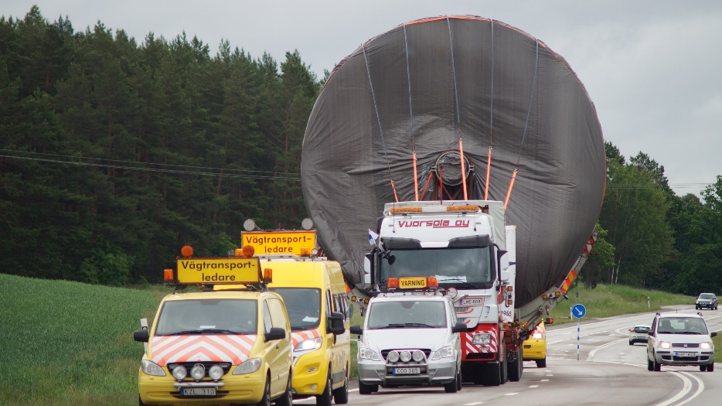
SKÄRBLACKA AND GRUVÖN WELL UNDER WAY
IMPROVING EFFICIENCY AND SECURING GROWTH
A Yankee cylinder of 160 tons on the move from Tervasaari to Skärblacka
Investing in MG integrated to pulp production in Skärblacka, Sweden;
SEK 1,3 billion investment.
New board machine in Gruvön, Sweden with capacity of approx. 550 000 t/a;
SEK 5,7 billion investment.
Notes:
Our ongoing investments in Skärblacka and Gruvön continue according to plan. We are glad to see that the start-up of these projects has been successful and that they are well under way.
Gruvön is one of the largest investments in Sweden in recent years and will streamline our production structure. Startup is planned for early 2019 and the machine will be EBITDA positive by 2020. The current paper production at Gruvön will be gradually transferred to other plants during ramp up of the new machine with the aim to offer customers fully satisfactory alternatives. Gruvön’s production of high quality fluting will not be affected by the investment.

Slide 38
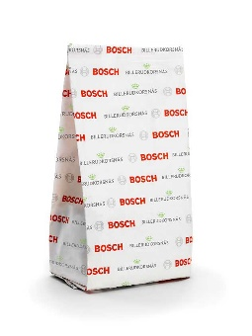
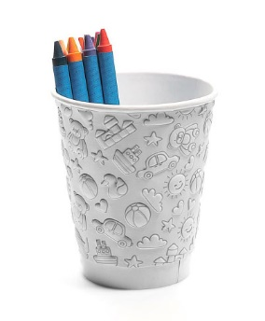
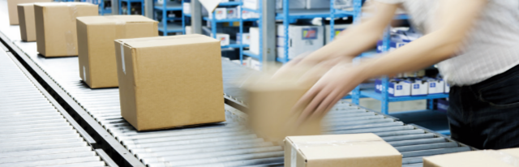
UNDERSTANDING SOLUTION SALES
CONCEPT DEFINITIONS
Packaging Solutions
Ready-to-use packaging solutions
  BillerudKorsnäs sells ready-made packaging
  May use BillerudKorsnäs material
  Examples:
    Managed Packaging
    Sack Sales
Systems Solutions
Product solutions including both materials and machine (and machine service)
  Products using BillerudKorsnäs material
  Examples:
    Axello ZAP
    Formable Solutions
Notes:
Primary fibre-based material with high sustainability performance is our core business, but alongside this, our solutions-based offerings are growing rapidly. This is being driven by both demand for a comprehensive offering in which the material is a key component, and by other types of solutions and packaging services.
We want to become more informative on the meaning and content of solutions sales. This slide shows the concept definitions with Packaging Solutions, where Managed Packaging is one part, and Systems Solutions, where the Axello ZAP is an example.
This is a teaser, and we will speak more on this as well as the investments in Skärblacka and Gruvön on our CMDs in November.

Slide 39
appendix

Slide 40
Global packaging market
GLOBAL PACKAGING MARKET,
BY REGION¹
GLOBAL PACKAGING MARKET,
BY MATERIAL¹
1. Source: Smithers Pira 2014

Slide 41

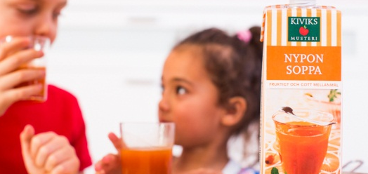
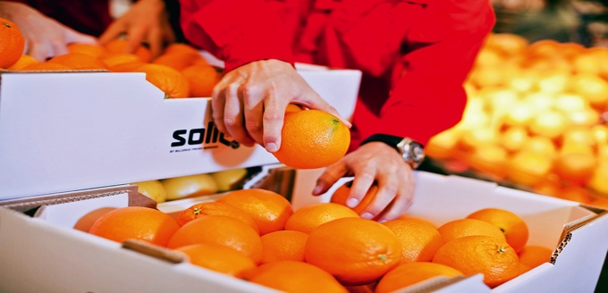
Sales per region
PACKAGING PAPER
CONSUMER BOARD
CORRUGATED SOLUTIONS
SALES PER REGION
Europe 69%
Asia 15%
Africa 7%
South America 4%
Middle East 1%
Other 4%
SALES PER REGION
Europe 70%
Asia 22%
Middle East 4%
Africa 2%
South America 2%
SALES PER REGION
Europe 69%
Asia 21%
Africa 4%
South America 3%
Other 3%
All figures relate to sales in 2016

Slide 42
Billerudkorsnäs capex 2015-2019
CAPEX
SEK 4 700m
SEKm
SEK 4 500m
SEK 1 500m

Slide 43
COST STRUCTURE
No significant forest assets
Purchases made from handful of major suppliers
  Bergvik Skog, Holmen, Mellanskog, Norra Skogsägarna, Stora Enso and Sveaskog
  Large amount of private land owners in Central and Northern Sweden
The majority of wood raw materials acquired locally
Approximately 20% of the wood requirement is purchased outside Sweden
  Majority from the Baltics
43
All figures relate to cost structure 2016

Slide 44
Sensitivity analysis
IMPACT ON PROFIT/LOSS BEFORE TAX
Variable | Change | SEKm
Sales volume | +/- 10% | +/-900
Exchange rate, SEK¹ | +/- 10% | -/+640
Fibre prices | +/- 10% | -/+700
Price of electricity² | +/- 10% | -/+30
Interest rate on loans³ | +/- 1 percentage point | -/+43
1 Excluding effects of currency hedging.
2 Excluding effects of electricity price hedging.
3 Excluding effects of interest hedging.
44

Slide 45
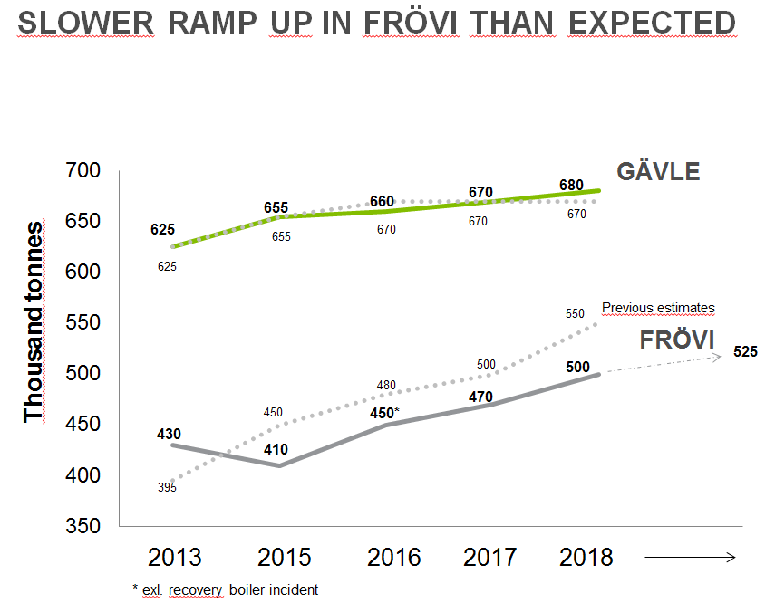
Production units
SWEDEN
Gävle, 725 ktonnes
Gruvön, 685 ktonnes
Frövi/Rockhammar, 470 ktonnes
Skärblacka, 420 ktonnes
Karlsborg, 300 ktonnes
FINLAND
Pietarsaari, 200 ktonnes
Tervasaari, 100 ktonnes
UNITED KINGDOM
Beetham, 45 ktonnes
Total production capacity 2 945 ktonnes
45
All figures relate to production capacity 2015

Slide 46
BillerudKorsnäs Share
Symbol: BILL
Trading platform: Nasdaq Stockholm
IPO: November 20, 2001
Share performance 2017
Share performance 2006-2016

Slide 47
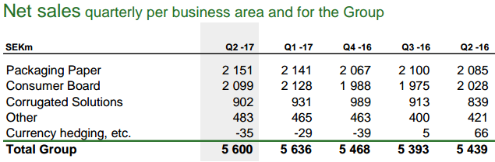
FX risk
Total net currency exposure of SEK 6.4 billion
BK uses Swedish Riksbank’s FIXING rate (Month End)
During month Sales, AP, AR etc: End of month rate previous month
AP and AR: revalued to at end of month using End of month rate.
    Revaluation of AR booked in ”Currency hedging etc”
    Revaluation of AP in Business areas
FX contracts: Market value at month end. Contracts due within two months in Sales (”Currency hedging, etc”), rest is booked in Balance Sheet (OCI).
GBP 10%
USD 30%
EUR 60%
Average
hedge rates
EURSEK 9,61
USDSEK 8,85
GBPSEK 11,15
FX hedging policy
  0-80% of flows over coming 15 months
  0% is default hedge level
  No speculation in FX movements
2017-06-30

Slide 48
DEBT maturity and funding
DEBT MATURITY PROFILE
FUNDING
Syndicated credit facilities
  SEK 5,500m RCF maturing June, 2022 – back bone funding
Bilateral credit agreements
  Mix of short and long term funding
Bonds
  MTN Program frame SEK 5,000m of which SEK 3,500m issued
Commercial Paper
  CP Program SEK 3,000m, issued SEK 0m
Financial covenants
  Net Debt / Equity <1.25 (2017 Q2 at 0.36)
  EBITDA / Net financial expenses >3.00 (2017 Q2 at 22.2)
Lease commitments payable within one year SEK 99 million and total commitment of SEK 283 million (year end 2016).
STRATEGY
Financial target Net Debt / EBITDA < 2.5
Sources of liquidity in the coming 12 months to exceed uses by a factor of 1,20
Diversified funding sources and an even maturity profile
2017-06-30

Slide 49
Ownership structure
Ownership structure per 2017-06-30

Slide 50
